Slide 1

Using Zoom AI Companion Team chat Part 4

Slide 2

“I’ve learned that the key to a successful Zoom call is having a strategically placed bookshelf behind me to look smart.”

Slide 3




Notes:
https://www.youtube.com/channel/UC35ZpwldGw7ZJ5R-2sLijzw

Slide 4
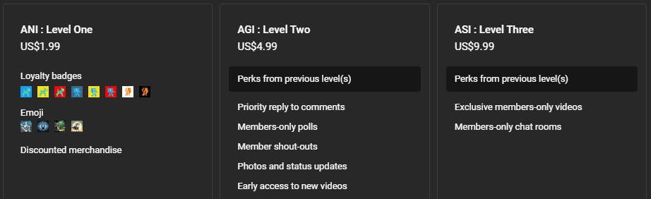

Membership has its privileges
Notes:
https://www.youtube.com/channel/UC35ZpwldGw7ZJ5R-2sLijzw/join

Slide 5
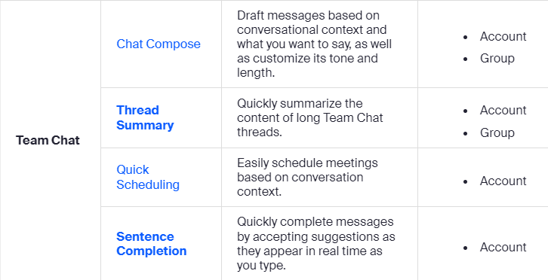

Slide 6
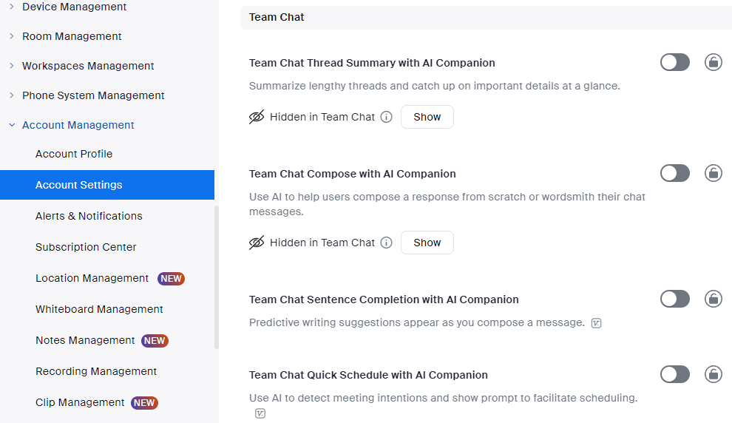

Slide 7

Team Chat Compose
Notes:
https://support.zoom.com/hc/en/article?id=zm_kb&sysparm_article=KB0058033

Slide 8
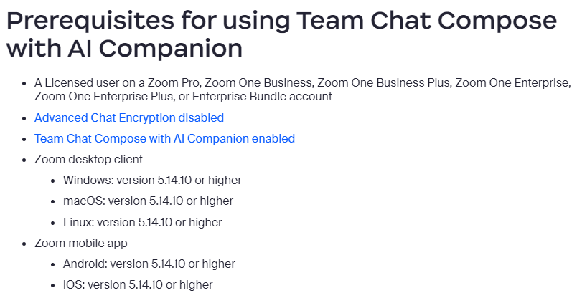

Slide 9
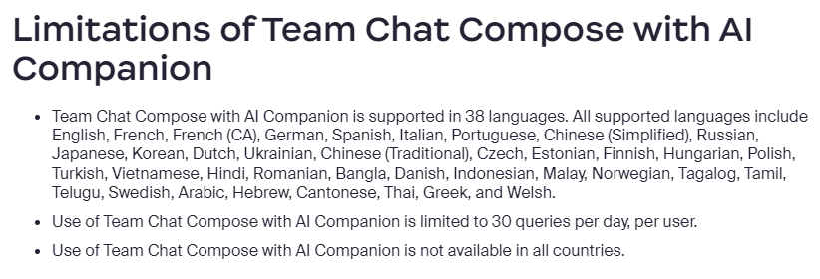

Slide 10
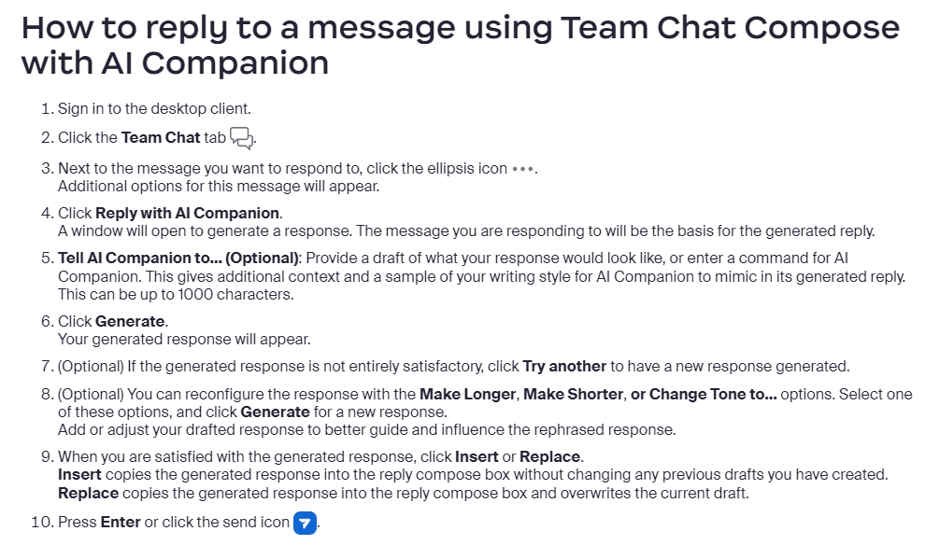

Slide 11
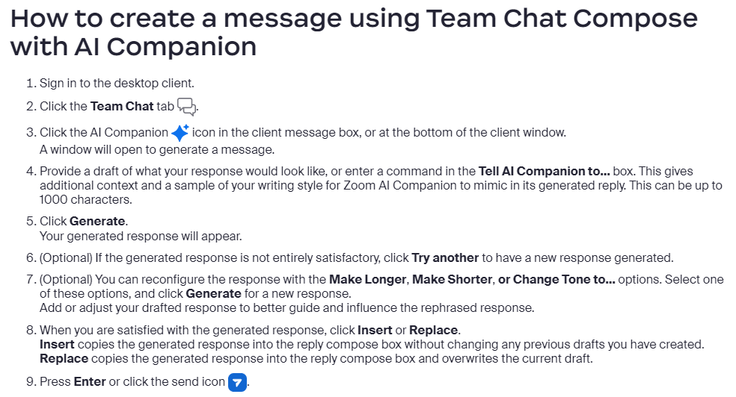

Slide 12
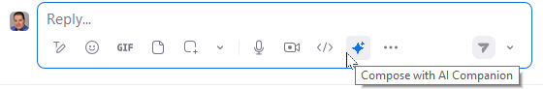
Demo: Team Chat Compose

Slide 13

Thread Summary
Notes:
https://support.zoom.com/hc/en/article?id=zm_kb&sysparm_article=KB0057619

Slide 14
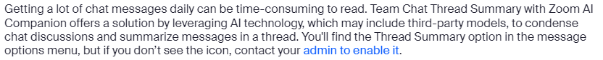
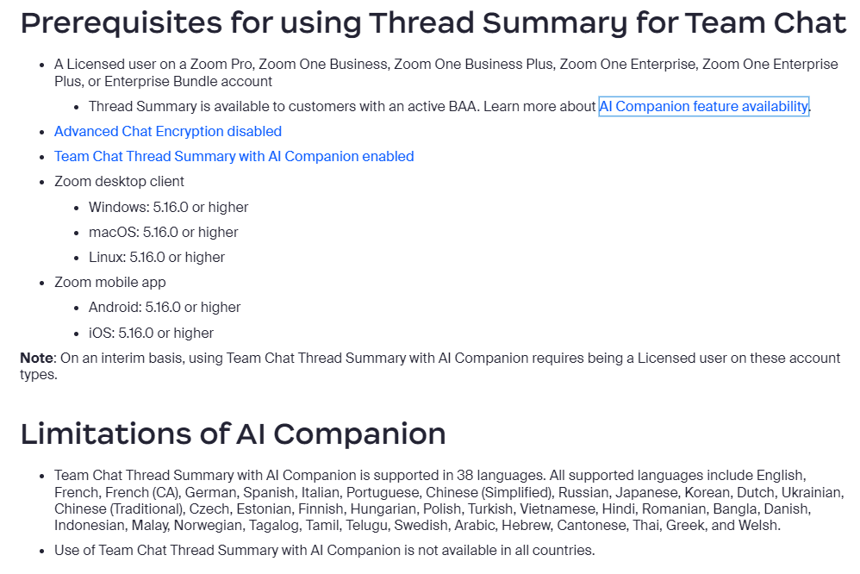

Slide 15
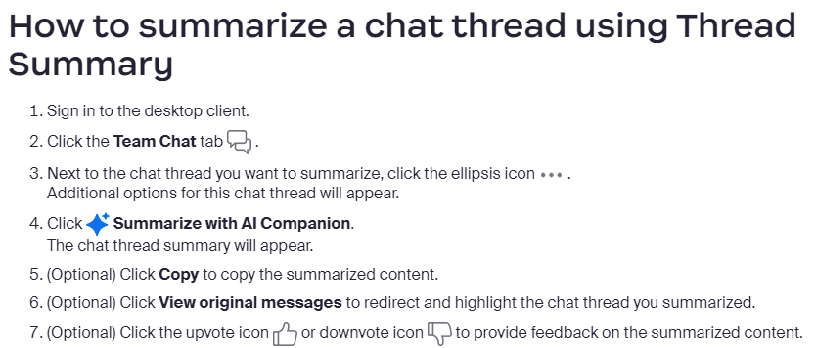

Slide 16
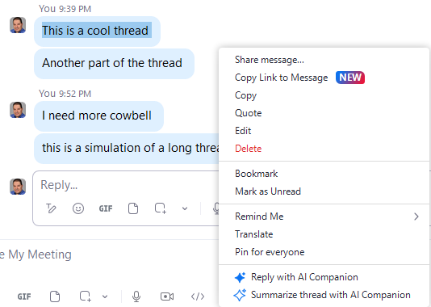
Demo: Thread Summary

Slide 17

Sentence Completion
Notes:
https://support.zoom.com/hc/en/article?id=zm_kb&sysparm_article=KB0075080

Slide 18
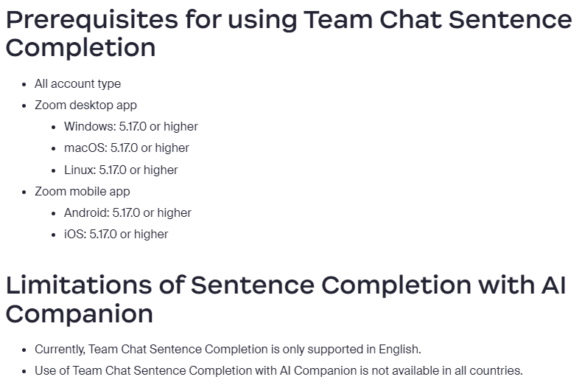

Slide 19
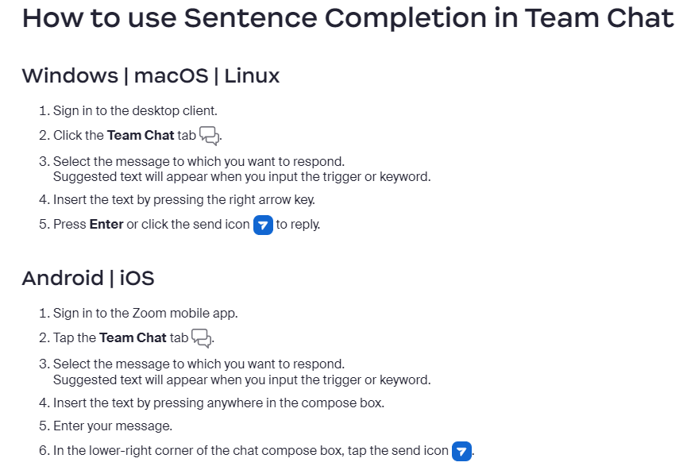

Slide 20
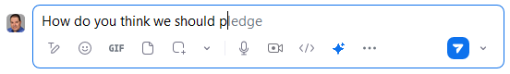
Demo: Sentence Completion

Slide 21

Quick Schedule
Notes:
https://support.zoom.com/hc/en/article?id=zm_kb&sysparm_article=KB0073984

Slide 22
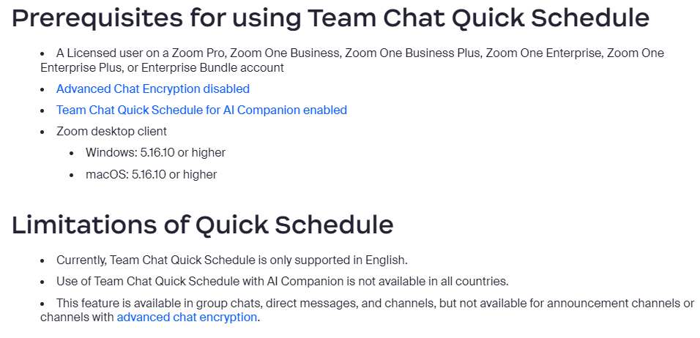

Slide 23
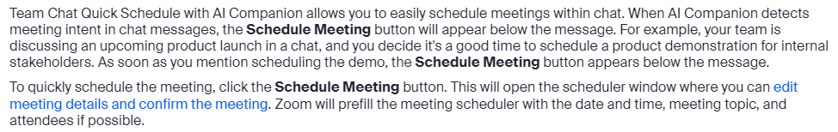

Slide 24
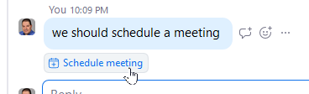
Demo: Quick Schedule

Slide 25


